Slide 1

WAY TO ENTERPRISE
React JS
VTI ACADEMY
Author: duy.nguyenngoc1@vti.com.vn
March 2020

Slide 2
Agenda
Hook
Assignments
Copyright © VTI Academy All Rights Reserved

Slide 3
Hook
Added in React version 16.8
Allow Functional Component to use lifecycle as Class Component
Reuse code
Built-in Hook
State hook
Effect hook
Context hook
…
Custom Hook
React memo (HOC)
Memo hook
Callback hook
Reducer hook

Slide 4
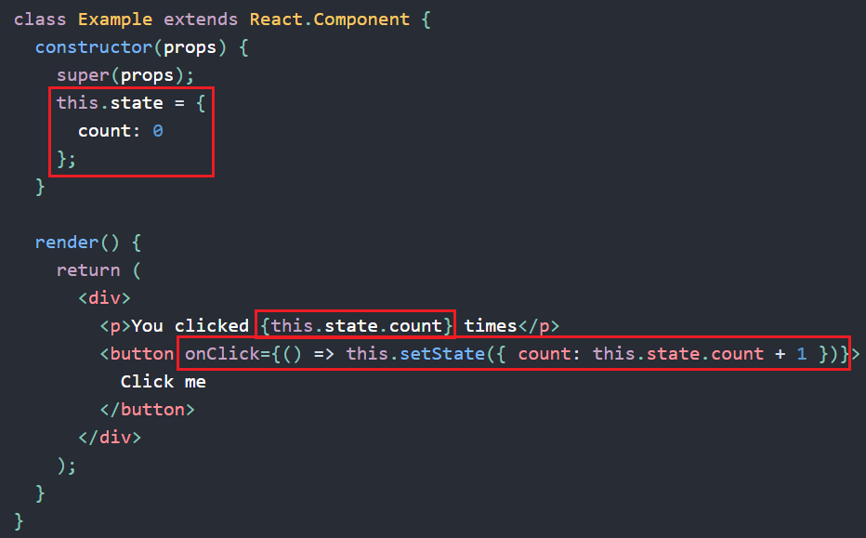
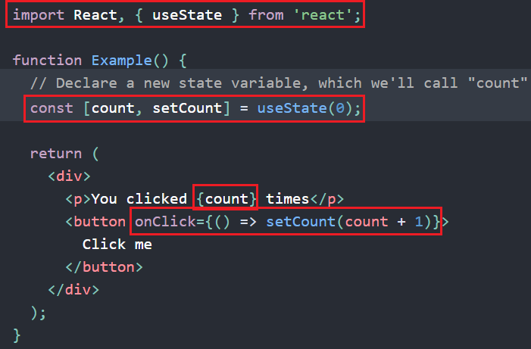
State Hook
Using state in functional component
Cannot merge state
State hook
Class component
Array Destructuring
View source code in Lesson_8_Resource

Slide 5
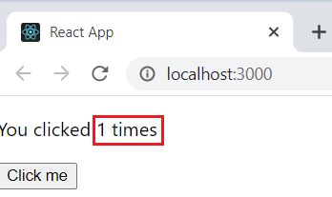
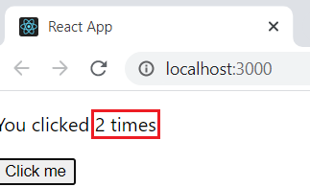
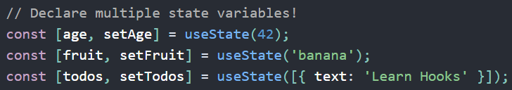
State Hook
Multiple State Hook

Slide 6
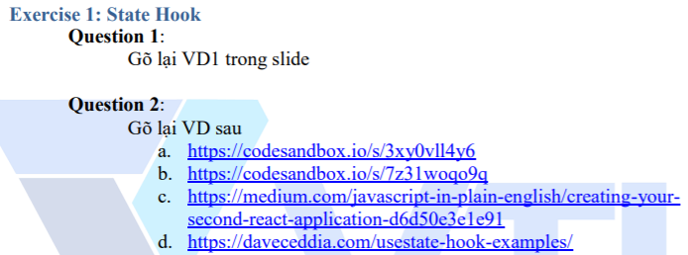
Testing System Assignment
Exercise 1: State Hook

Slide 7
Effect Hook
Run some code after rendering (DOM changes)
instead of componentDidMount(), componentDidUpdate() and componentWillUnmount()
props and state are accessible

Slide 8
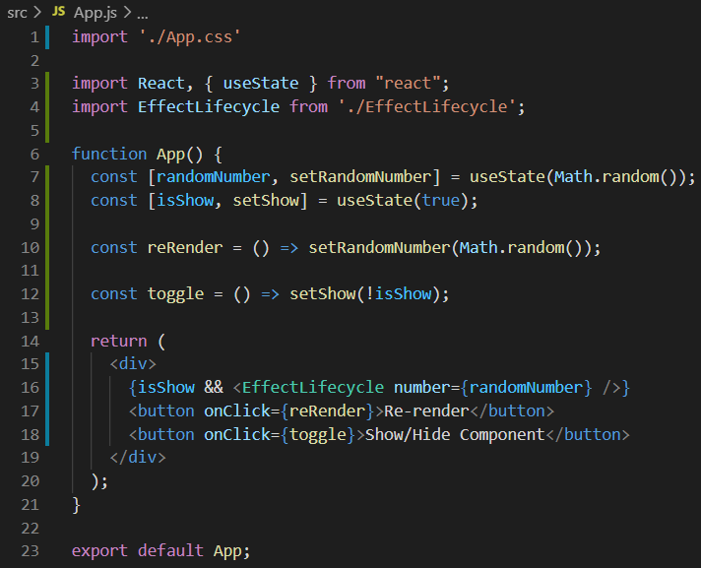
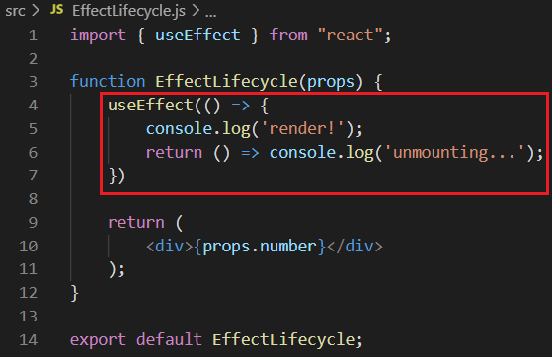
Effect Hook
Lifecycle
View source code in Lesson_8_Resource

Slide 9
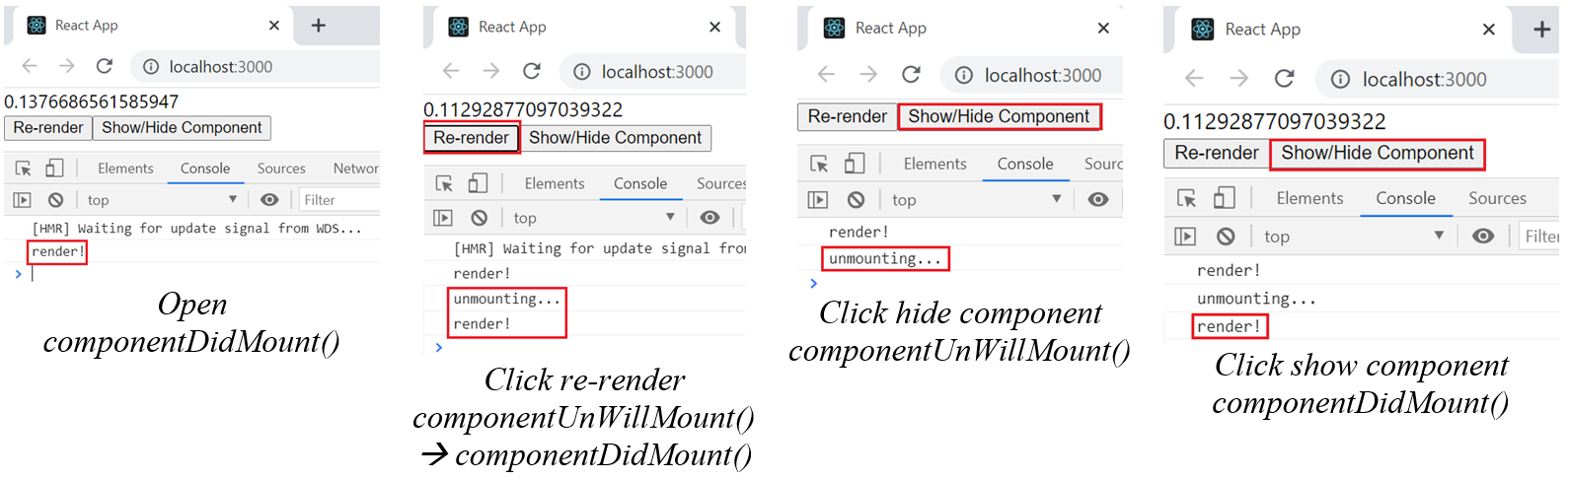
Effect Hook
Lifecycle
Run after componentDidMount(), componentDidUpdate()
Run before componentWillUnmount()

Slide 10
Testing System Assignment
Self-practice

Slide 11
Effect Hook
Types
No need Clean up
Run some code after React has updated the DOM
Clean up
Remove event (prevent memory leak)

Slide 12
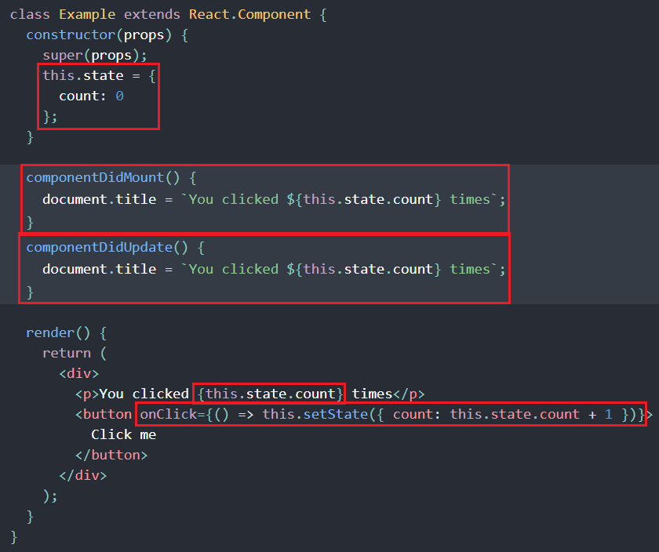
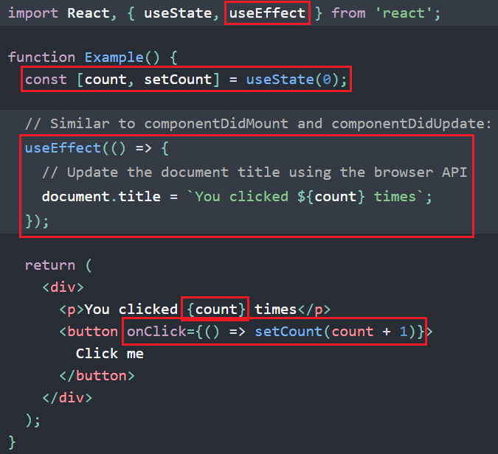
No need Clean up
Example 1: update document title after rendering
Class component
Effect hook
Repeat logic in 2 lifecycle methods

Slide 13
Testing System Assignment
Self-practice

Slide 14
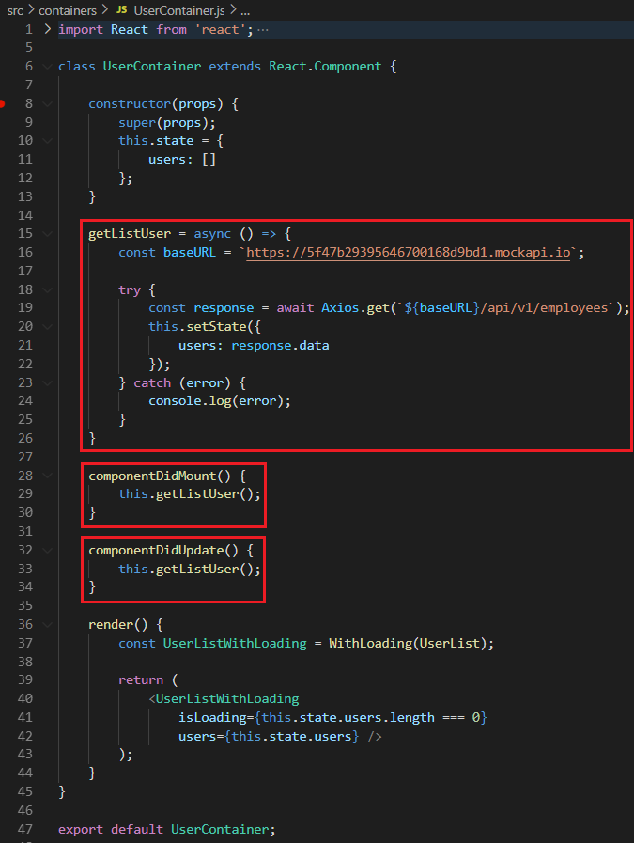
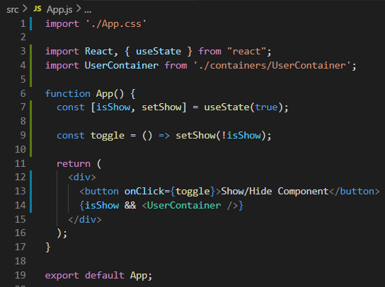
Clean up
Example 1: Cancel Request

Slide 15
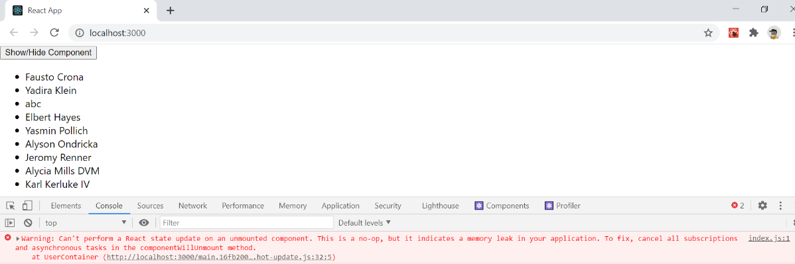
Clean up
Example 1: Cancel Request
If the component is hidden too quickly, it will cause memory leak
➔ fix: cancel request when unmounting

Slide 16
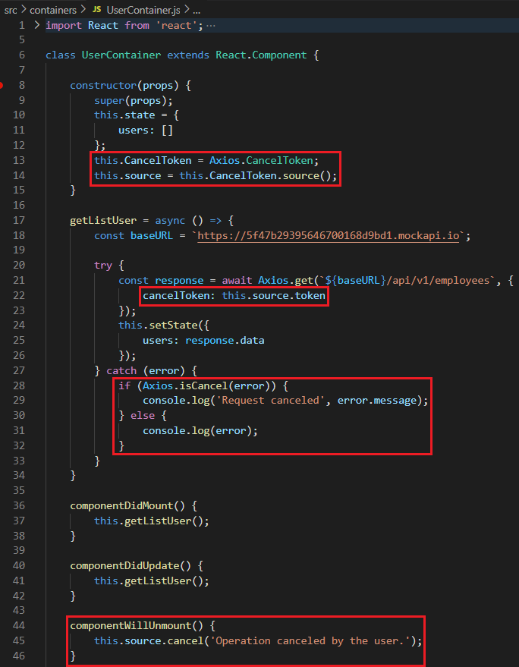
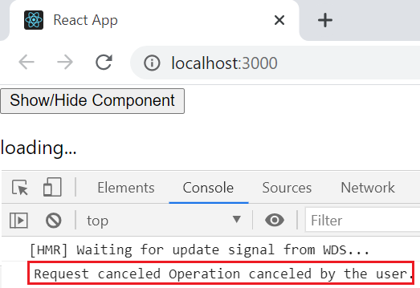
Clean up
Example 1: Cancel Request
https://github.com/axios/axios#cancellation

Slide 17
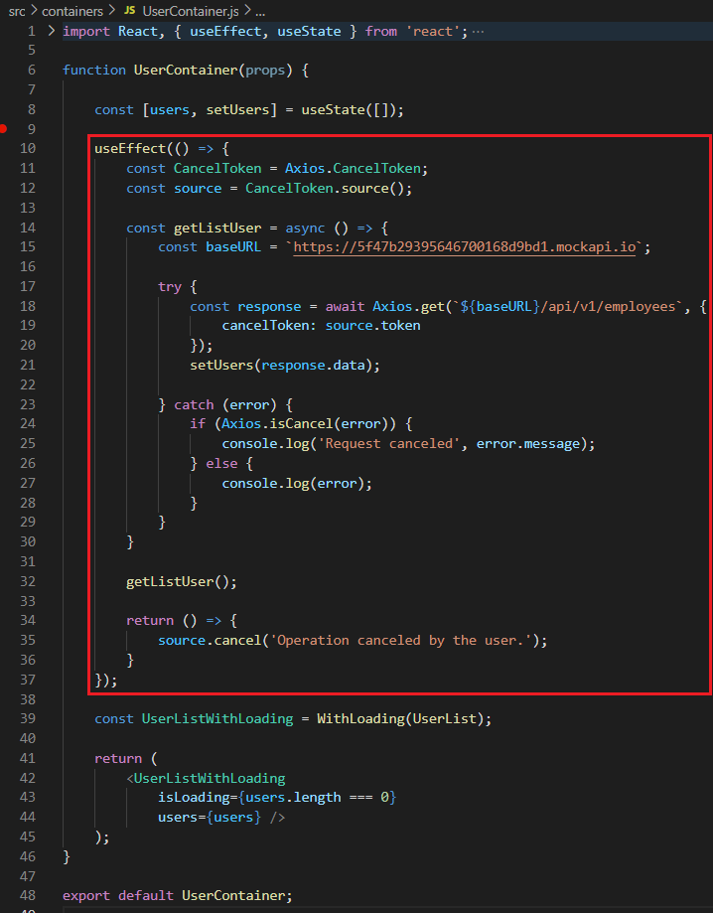
Clean up
Example 1: Cancel Request
useEffect()

Slide 18
Testing System Assignment
Self-practice

Slide 19
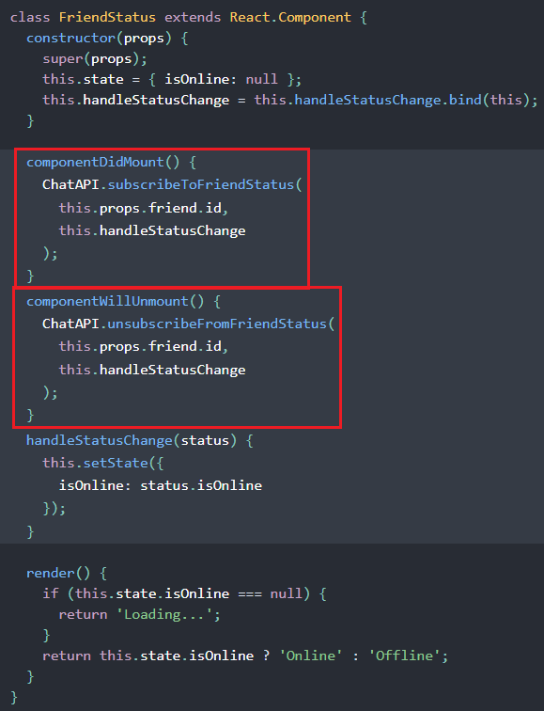
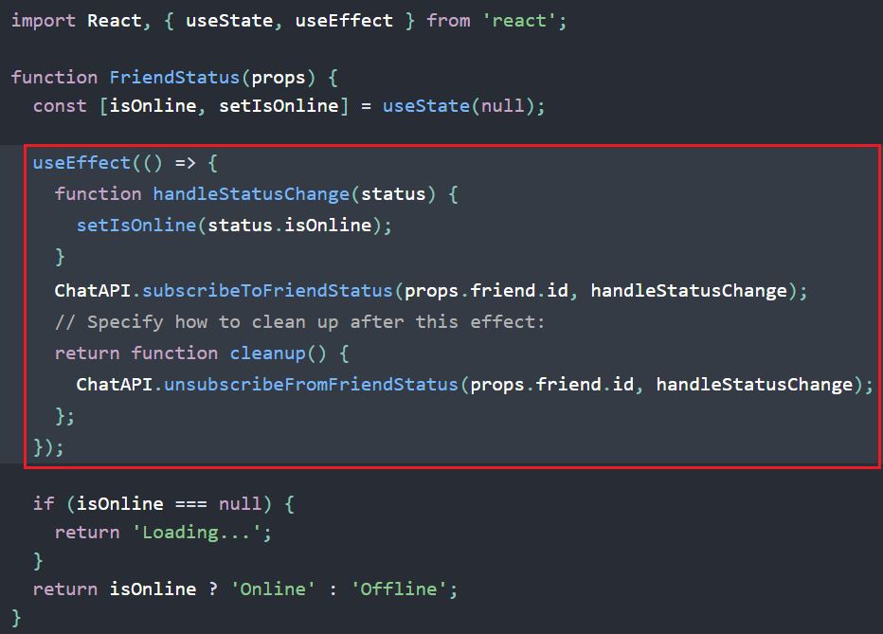
Clean up
Example 2: subscribe online status
Effect hook
Class component
The subscription and unsubscription come in two different methods

Slide 20
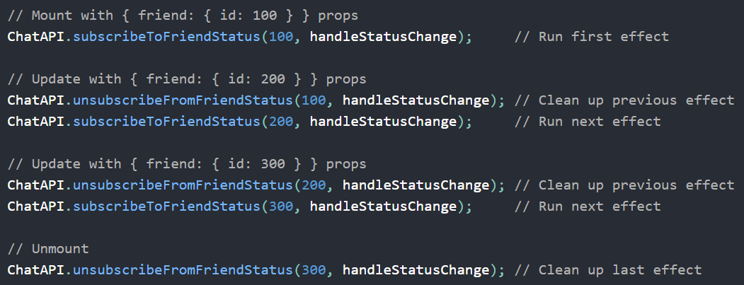
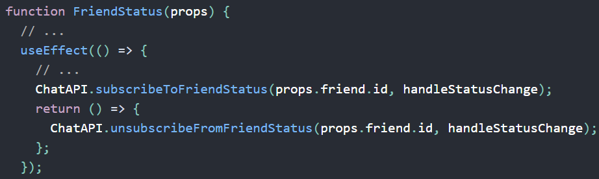
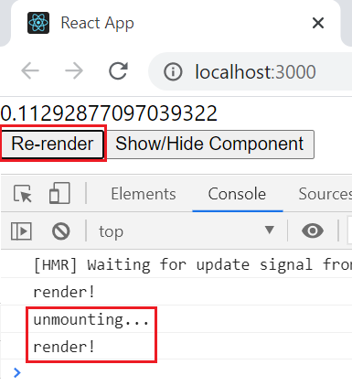
Clean up
Perform a cleanup effect every time re-render
Effect hook
Class component

Slide 21
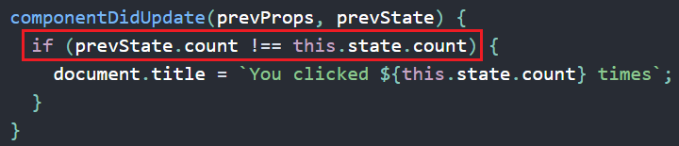
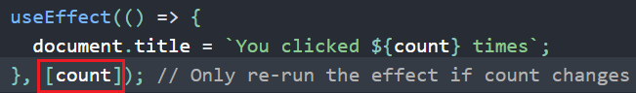
Effect Hook
re-render with condition
Effect hook
Class component

Slide 22
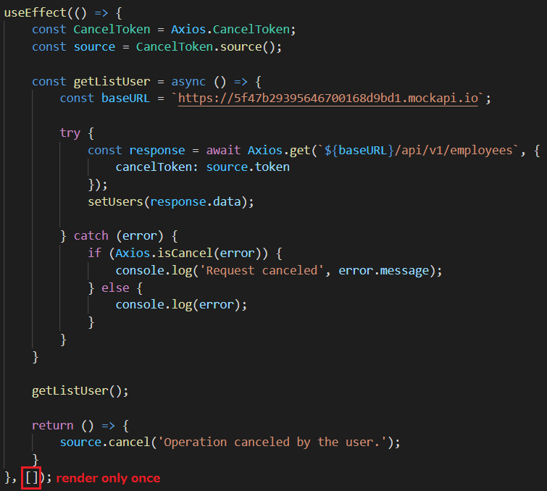
Effect Hook
If passed to an empty array React only runs 1 effect and cleans it only once (at mounting and unmounting) which means the effect is not dependent on any value (often used to avoid re-rendering too much)

Slide 23
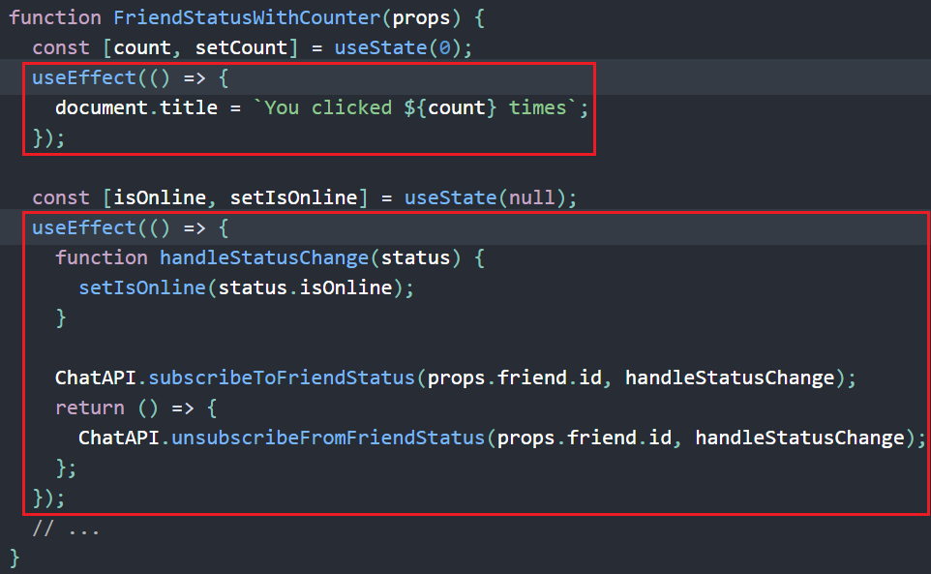
Effect Hook
Multiple Effect Hook
Split code based on Meaning (not by lifecycle method)

Slide 24
Testing System Assignment
Self-practice

Slide 25
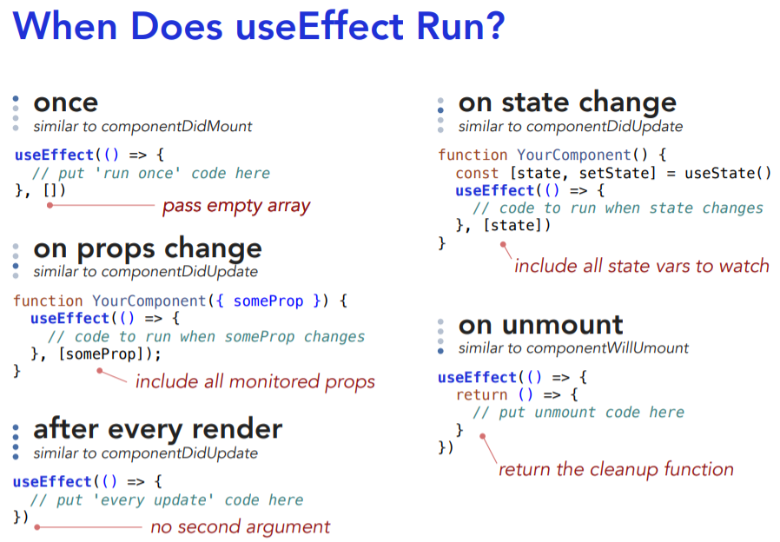
Effect Hook Summary
Syntax
https://daveceddia.com/useeffect-hook-examples/

Slide 26
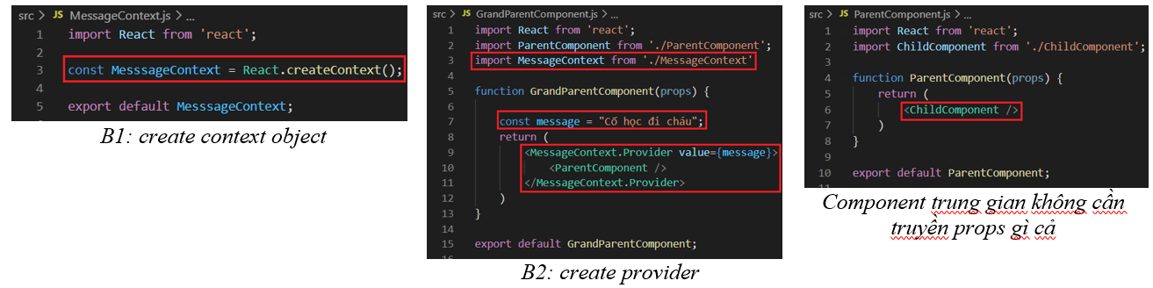
Context Hook
Allows to work with the context of functional components
Example 1: Context (previous lesson)

Slide 27
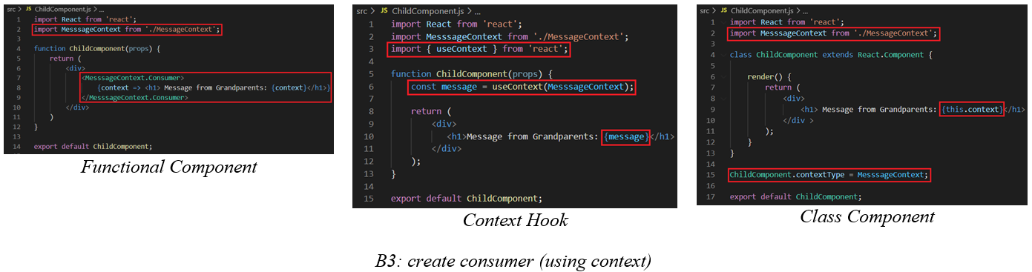
Context Hook
View source code in Lesson_8_Resource

Slide 28
Testing System Assignment
Self-practice

Slide 29
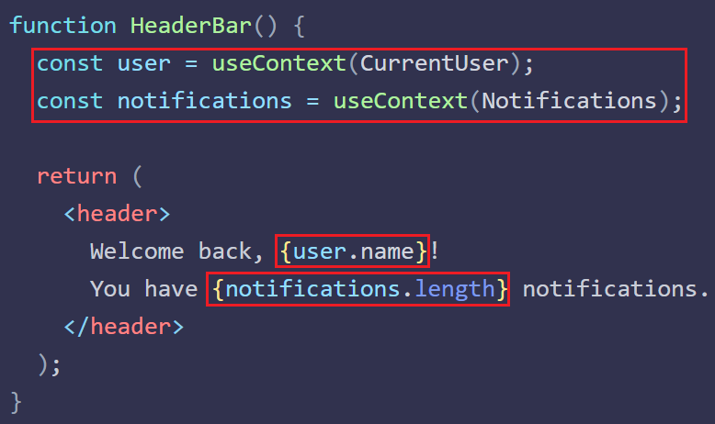
Context Hook
Example 2: Multiple Context

Slide 30
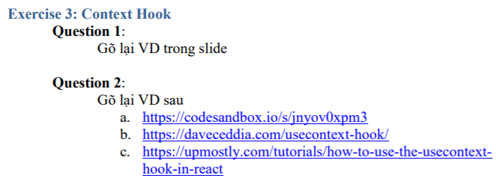
Testing System Assignment
Exercise 3: Context Hook

Slide 31
Custom Hook
Javascript function
Allows splitting common logic in components into reusable functions (like the ScannerUtils file, HibernateUtils file in Java)
Separate complex logic and UI in component
Share logic between components
Multiple custom hook writed by React Community

Slide 32
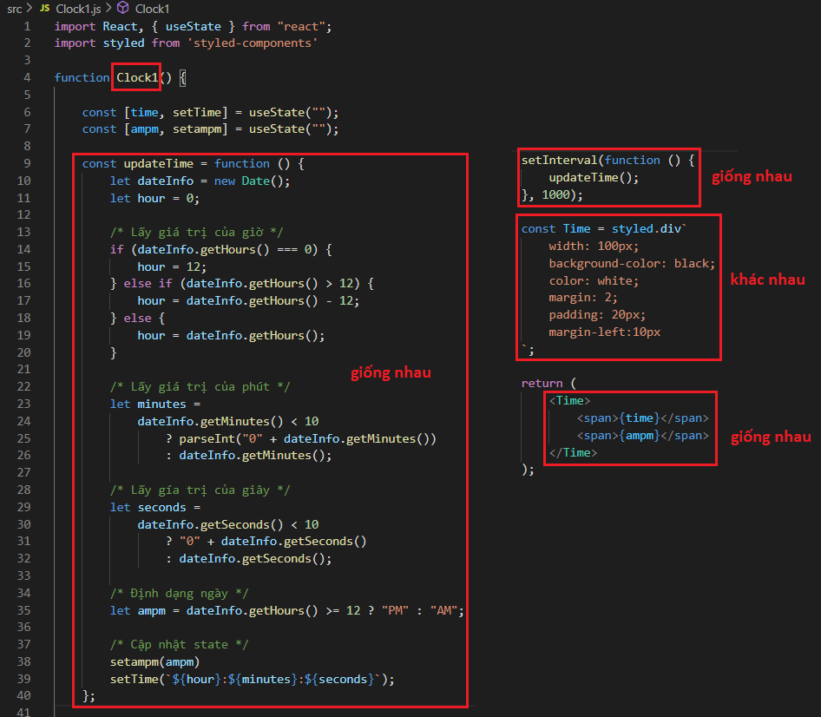
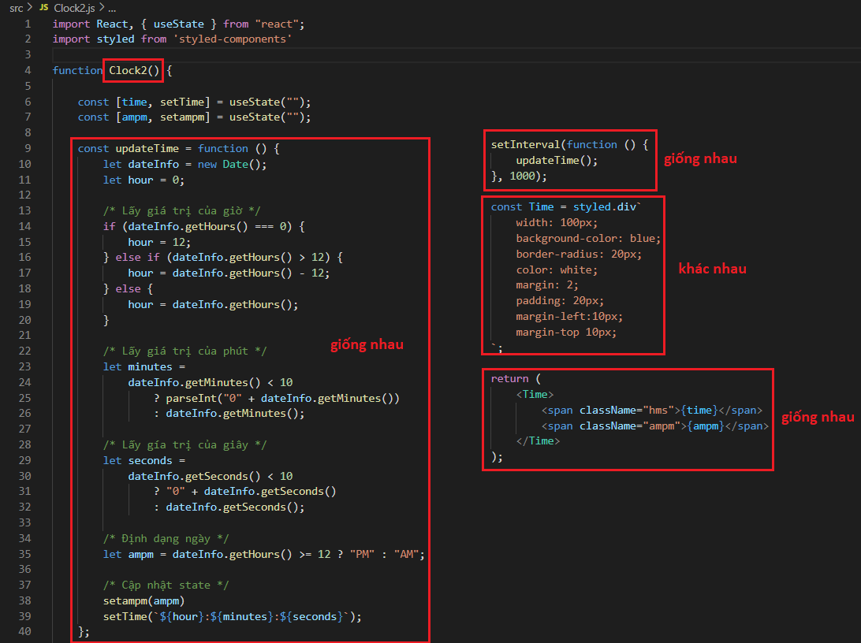
Custom Hook
Example
View source code in Lesson_8_Resource

Slide 33
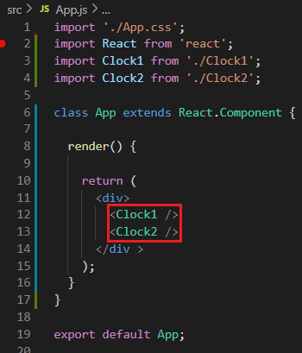
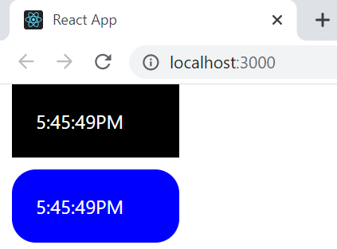
Custom Hook
100 clock ➔ write 100 times ➔ repeat logic

Slide 34
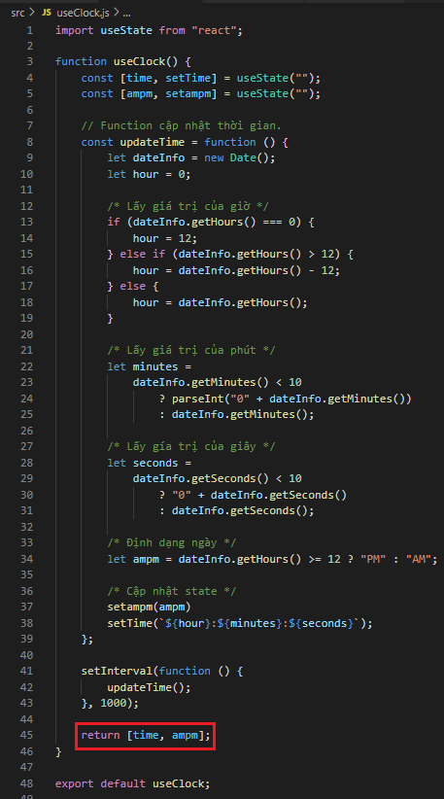
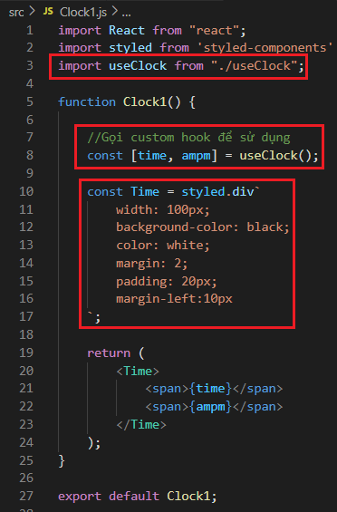
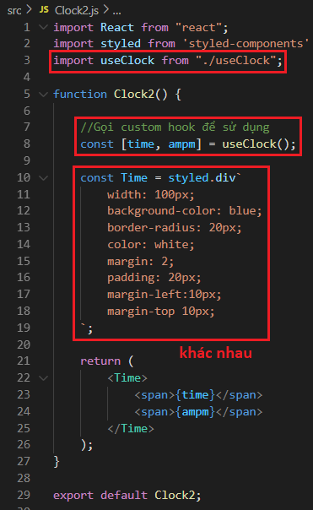
Custom Hook
Using Custom Hook
Custom Hook
Clock 1
Clock 2
Contain common logic

Slide 35
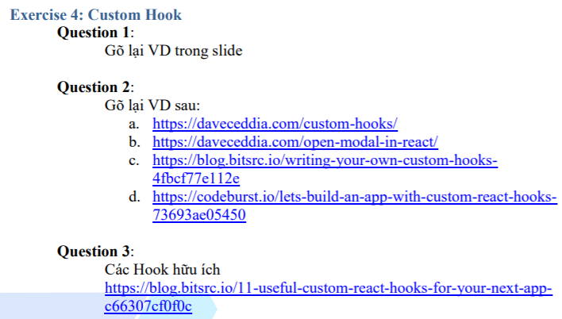
Testing System Assignment
Exercise 4: Custom Hook

Slide 36
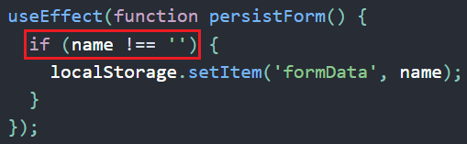
Hook Coding Convention
Using keyword use for naming
Only Call Hooks at the Top Level (Don’t call Hooks inside loops, conditions, or nested functions)
Only Call Hooks from React Functions
Hook with condition
https://www.npmjs.com/package/eslint-plugin-react-hooks
Using eslint plugin react hook to check coding convention for Hook writing

Slide 37
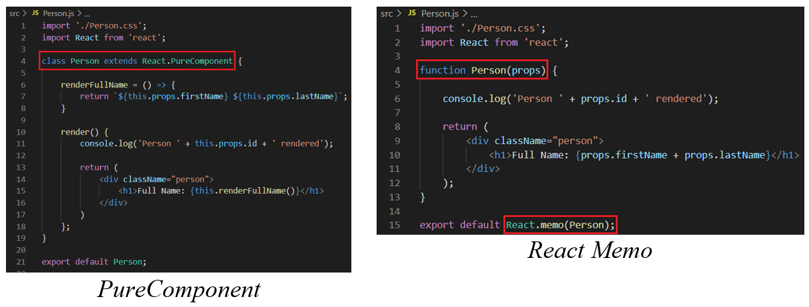
React Memo
is a HOC (not Hook)
similar to PureComponent (Using PureComponent for Class component, Using React memo for functional component)
View source code in Lesson_8_Resource

Slide 38
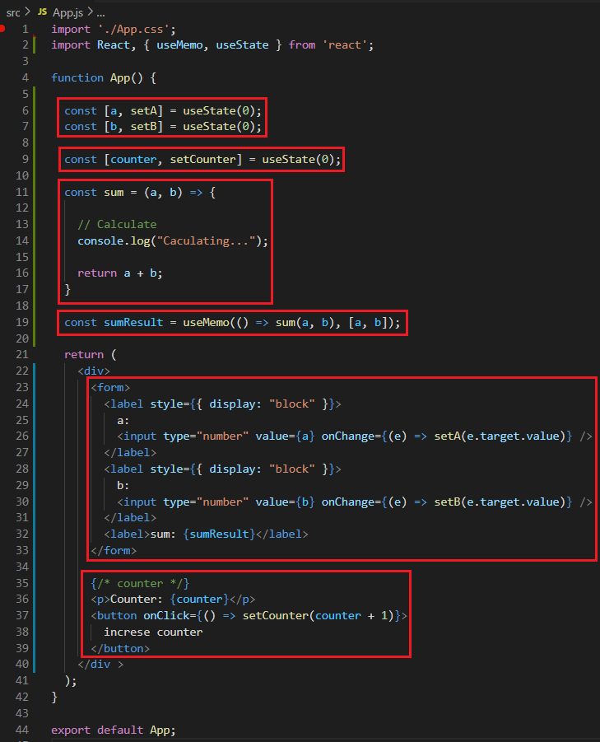
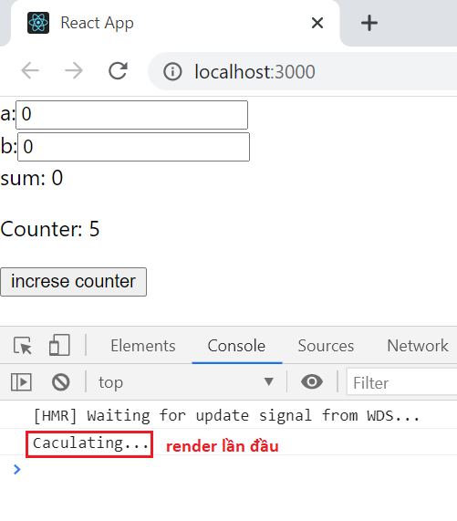
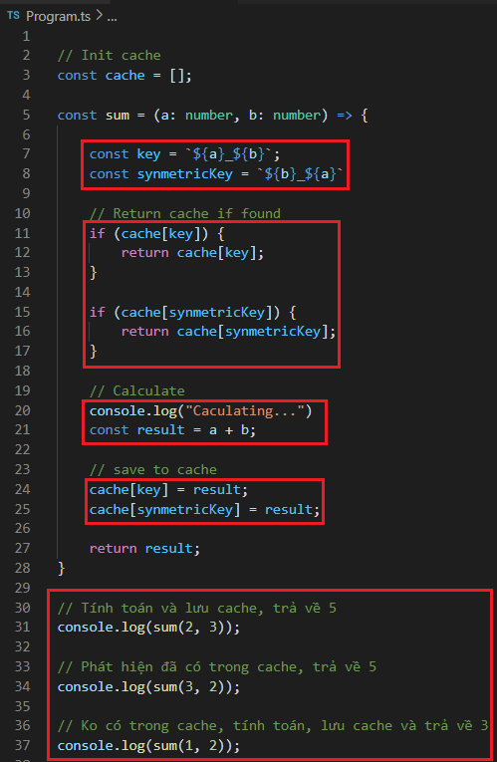
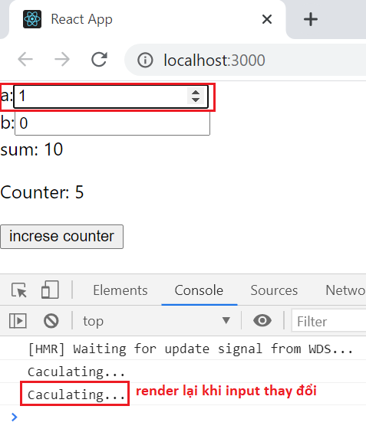
Memo Hook
Optimize the calculation expensive function
Example 1:

Slide 39
Testing System Assignment
Self-practice

Slide 40
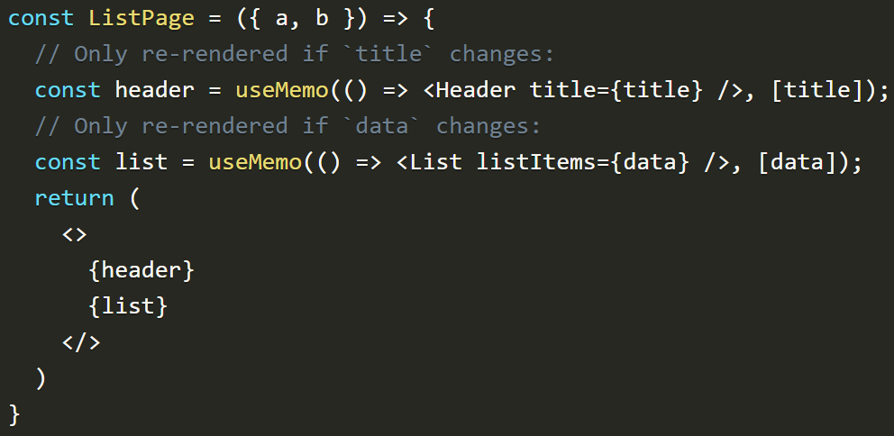
Memo Hook
pass to 1 function (to calculate) and 1 array dependencies
Example 2:
https://codesandbox.io/s/q87kznyp69
Example 3:

Slide 41
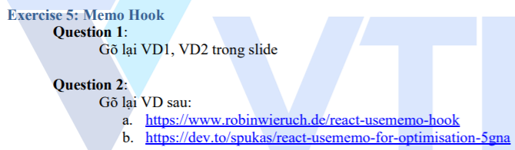
Testing System Assignment
Exercise 5: Memo Hook

Slide 42
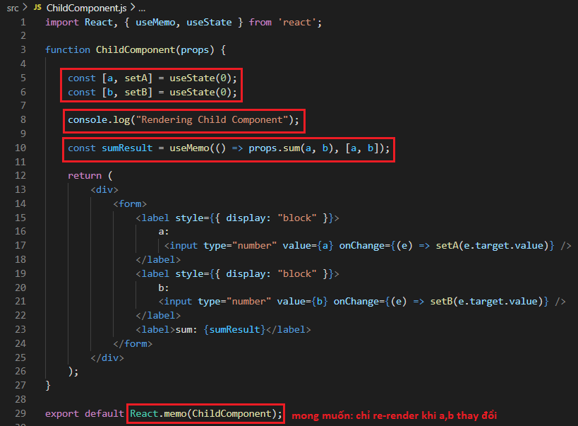
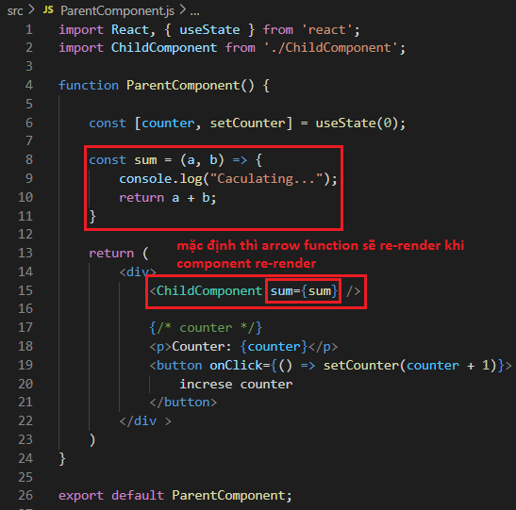
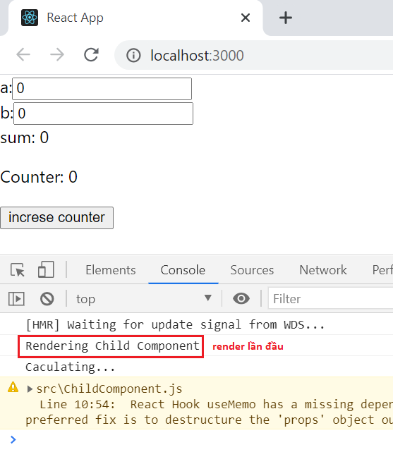

Callback Hook
Similar to useMemo() but prevents callback functions re-create when parent component re-render
Child component
Parent component
By default when the Parent Component re-render which will re-render the arrow functions
references pointing to the arrow function will change ➔ leading to the props in the child component will change
the child component is re-rendered (even used PureComponent or React Memo) ➔ use callback to fix it

Slide 43



Callback Hook
Using callback hook
View source code in Lesson_8_Resource

Slide 44
Testing System Assignment
Self-practice

Slide 45


Callback Hook
Should do some heavy task like:
Render chart
Animation
...

Slide 46

Callback & Memo Hook

Slide 47



Reducer Function
Syntax

Slide 48

Reducer Hook
Similar to state hook, manage complex state
Work like Reduce Function
Syntax
Callback function: Get a state and an action and return a new state
userReducer():Take in a callback and return the last state (accumulator) and dispatch function

Slide 49

Reducer Hook
Example 1:
State hook
Reducer hook
View source code in Lesson_8_Resource

Slide 50
Reducer Hook
Example 1:
dispatch(action) function

Slide 51


Reducer Hook
Example 2:
Action is object

Slide 52
Other
Ref Hook
Layout Effect Hook
Debug Value Hook
...

Slide 53

Testing System Assignments

Slide 54
Reference
https://reactjs.org/docs/getting-started.html
https://www.javatpoint.com/reactjs-tutorial
https://www.udemy.com/course/react-the-complete-guide-incl-redux

Slide 55
Q & A
Copyright © VTI Academy All Rights Reserved

